Slide 1


Networking #notes from the field
Thorsten Butz
Notes:
PowerShell Conference Europe
Hannover, 2016
www.psconf.eu

Slide 2





# about_me
$speaker = @{
name='Thorsten Butz'
jobrole = 'Trainer','Consultant','Author'
certification = 'MC*','LPIC-2'
= @thorstenbutz
= gplus.to/thorstenbutz
= facebook.com/thbutz
= thorsten-butz.de
= slidingwindows.de
}
Notes:
______________________________________________________
______________________________________________________
______________________________________________________
______________________________________________________
______________________________________________________
______________________________________________________
______________________________________________________
______________________________________________________
______________________________________________________

Slide 3
Agenda
Networking with PoSh
Why?
Why not?
Basics
Testing network connectivity with Cmdlets
Depeche mode: classes, multithreading
Sneak peak:
SSH@PoSh
Windows Subsystem for Linux
Notes:
______________________________________________________
______________________________________________________
______________________________________________________
______________________________________________________
______________________________________________________
______________________________________________________
______________________________________________________
______________________________________________________
______________________________________________________

Slide 4
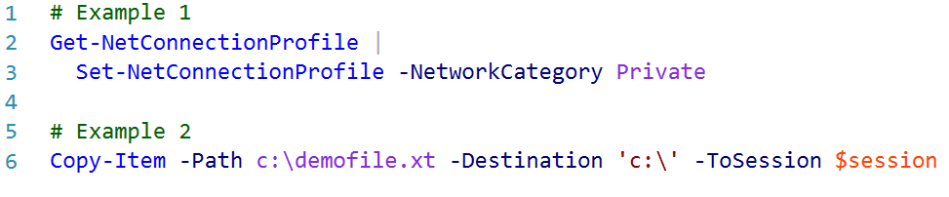
Why PoSh?
No other (or superior) option
(Custom) Objects
Remoting
Multithreading
Notes:
______________________________________________________
______________________________________________________
______________________________________________________
______________________________________________________
______________________________________________________
______________________________________________________
______________________________________________________
______________________________________________________
______________________________________________________

Slide 5
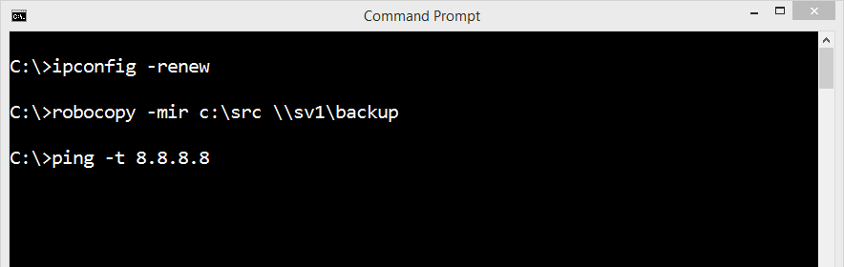
Why not?
Ugly and irritating: lots of CDXML code
Lack of functionality/performance
Inconsistency
Superior "legacy" apps:
Notes:
______________________________________________________
______________________________________________________
______________________________________________________
______________________________________________________
______________________________________________________
______________________________________________________
______________________________________________________
______________________________________________________
______________________________________________________

Slide 6
## Basics: the (W)MI classes
Get-CimClass -Namespace 'root/StandardCimv2'
-ClassName 'MSFT_Net*'
Get-CimInstance -Namespace 'root/StandardCimv2'
-ClassName 'MSFT_NetAdapter'
-ClassName 'MSFT_NetAdapterHardwareInfoSettingData'
-ClassName 'MSFT_NetAdapterBindingSettingData'
-ClassName 'MSFT_NetIPAddress'
-ClassName 'MSFT_NetIPInterface'
Notes:
______________________________________________________
______________________________________________________
______________________________________________________
______________________________________________________
______________________________________________________
______________________________________________________
______________________________________________________
______________________________________________________
______________________________________________________

Slide 7
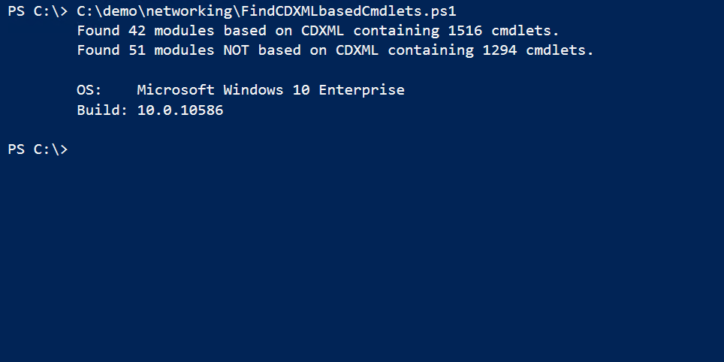
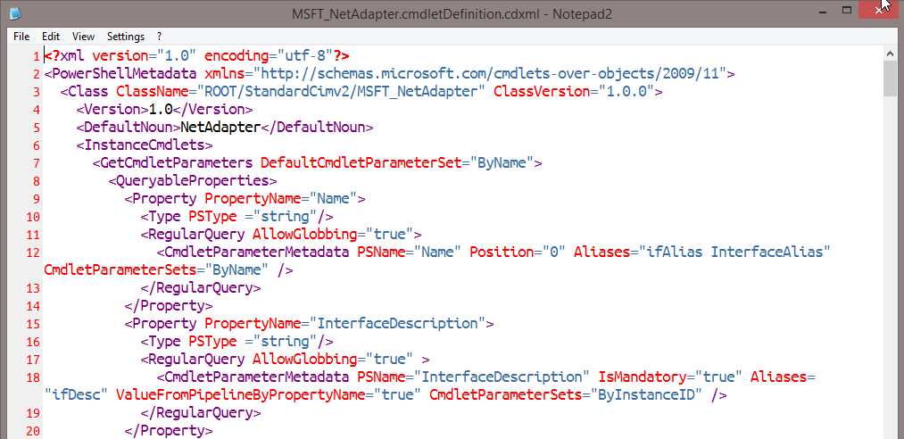
## CDXML
Get-CimInstance -Namespace 'root/StandardCimv2' `
-ClassName 'MSFT_NetAdapter' # 1
Get-NetAdapter # 2
Notes:
$modulesFolders = Get-ChildItem "$pshome\Modules" -Directory
$modulesCDXML = @()
$modulesNonCDXML = @()
foreach ($modulesFolder in $modulesFolders) {
$cdxml = Get-ChildItem -Path $($modulesFolder.fullname) -File -Filter *.cdxml -Recurse
if ($cdxml) {$modulesCDXML += $modulesFolder.name } else { $modulesNonCDXML += $modulesFolder.name }
}
# Counting commands ..
$a = $modulesCDXML.count
$b = (Get-Command -Module $modulesCDXML).count
$c = $modulesNONCDXML.count
$d = (Get-Command -Module $modulesNONCDXML).count
$os = (Get-CimInstance -ClassName Win32_OperatingSystem).caption
$version = (Get-CimInstance -ClassName Win32_OperatingSystem).version
"Found $a modules based on CDXML containing $b cmdlets."
"Found $c modules NOT based on CDXML containing $d cmdlets.`n"
"OS: $os"
"Build: $version"

Slide 8
Demo 1
Notes:
______________________________________________________
______________________________________________________
______________________________________________________
______________________________________________________
______________________________________________________
______________________________________________________
______________________________________________________
______________________________________________________
______________________________________________________

Slide 9
gip –detailed: Lack of information
c:\ipconfig.exe –all
Windows IP Configuration
Host Name . . . . . . . . . . . . : sea-cl1
Primary Dns Suffix . . . . . . . : contoso.com
Node Type . . . . . . . . . . . . : Hybrid
IP Routing Enabled. . . . . . . . : No
WINS Proxy Enabled. . . . . . . . : No
DNS Suffix Search List. . . . . . : contoso.com
Ethernet adapter Ethernet:
Connection-specific DNS Suffix . :
Description . . . . . . . . . . . : Hyper-V Virtual Ethernet Adapter #3
Physical Address. . . . . . . . . : 00-15-5D-00-08-52
DHCP Enabled. . . . . . . . . . . : Yes
Autoconfiguration Enabled . . . . : Yes
Link-local IPv6 Address . . . . . : fe80::b515:731b:633:3fba%46(Preferred)
Autoconfiguration IPv4 Address. . : 192.168.0.169 (Preferred)
Subnet Mask . . . . . . . . . . . : 255.255.255.0
DHCPv6 IAID . . . . . . . . . . . : 771757405
DHCPv6 Client DUID. . . . . . . . : 00-01-00-01-1C-19-00-48-C8-60-00-E3-70-DE
Notes:
______________________________________________________
______________________________________________________
______________________________________________________
______________________________________________________
______________________________________________________
______________________________________________________
______________________________________________________
______________________________________________________
______________________________________________________

Slide 10
## Review: Configuring NICs with PoSh
# .. only 1 IP address at a time!
New-NetIPAddress -InterfaceAlias $ifAlias -IPAddress '172.17.17.1'
-PrefixLength 24 -AddressFamily IPv4 –DefaultGateway '172.17.17.254'
Set-NetIPAddress -InterfaceAlias $ifAlias -IPAddress '172.17.17.1'
-PrefixLength 16 -AddressFamily IPv4
# "Remove-NetIPAddress" does not remove DefaultGateway:
Remove-NetIPAddress -InterfaceAlias $ifAlias -Confirm:$false
Remove-NetRoute -InterfaceAlias $ifAlias -Confirm:$false
# Set Array of DNSServers:
Set-DnsClientServerAddress -InterfaceAlias $ifAlias
-ServerAddresses '8.8.8.8','2001:4860:4860::8888'
MIND THE GAP
Notes:
______________________________________________________
______________________________________________________
______________________________________________________
______________________________________________________
______________________________________________________
______________________________________________________
______________________________________________________
______________________________________________________
______________________________________________________

Slide 11
## Review: Name resolution
Resolve-DnsName -Name 192.168.0.1
Resolve-DnsName -Name microsoft.com -Server 8.8.8.8
Resolve-DnsName -Name microsoft.com -CacheOnly
# Query explicitly by DNS, LLMNR or NetBIOS
Resolve-DnsName pc22 -LlmnrNetbiosOnly
Resolve-DnsName 8.8.8.8 -DnsOnly
# Query specific records
Resolve-DnsName -Name microsoft.com -Type MX
Resolve-DnsName -Name sixxs.net -Type AAAA
# Troubleshooting
Register-DnsClient # ipconfig.exe /registerdns
Clear-DnsClientCache # ipconfig.exe /flushdns
Notes:
______________________________________________________
______________________________________________________
______________________________________________________
______________________________________________________
______________________________________________________
______________________________________________________
______________________________________________________
______________________________________________________
______________________________________________________

Slide 12
# Module SmbShare vs. net.exe
Get-SmbShare # net share
New-SmbShare
Set-SmbShare
Remove-SmbShare
Get-SmbOpenFile # net file ...
Close-SmbOpenFile
Get-SmbSession # net session ...
Close-SmbSession
Get-SmbMapping # net use ...
New-SmbMapping
Remove-SmbMapping
Get-SmbServerConfiguration # net config ...
Set-SmbServerConfiguration
Get-SmbClientConfiguration
Set-SmbClientConfiguration
Notes:
The basics of SMB PowerShell, a feature of Windows Server 2012 and SMB 3.0
https://blogs.technet.microsoft.com/josebda/2012/06/27/the-basics-of-smb-powershell-a-feature-of-windows-server-2012-and-smb-3-0/

Slide 13

Dr Jekyll and Mr Hyde
Notes:
https://cdn-images-1.medium.com/max/800/1*Kf497eBBikYQSwm3o97-VA.png

Slide 14

## Credit to Trevor Jones: The "power ping"
# A: Build the class
class Ping
{
# Magic goes here!
}
# B: Scan the subnet
$ips = @()
1..254 | % {$ips += '192.168.0.' + $_ }
[ping]$test = $ips
$test.online
Highlight
Notes:
______________________________________________________
______________________________________________________
______________________________________________________
______________________________________________________
______________________________________________________
______________________________________________________
______________________________________________________
______________________________________________________
______________________________________________________

Slide 15
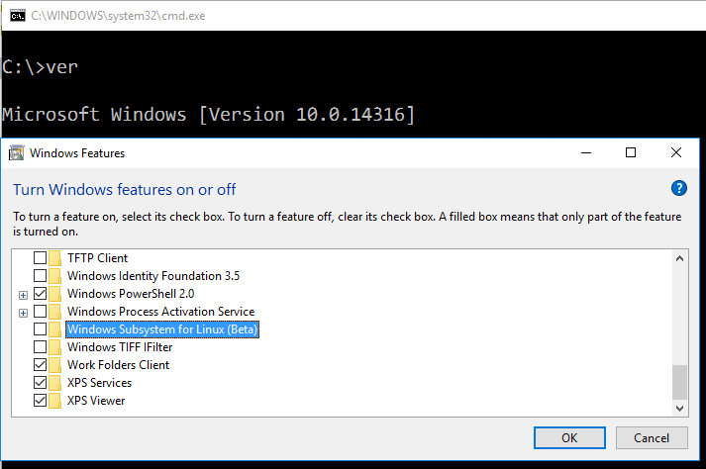
Get-WindowsOptionalFeature -Online -FeatureName *linux* |
Enable-WindowsOptionalFeature -Online
Notes:
______________________________________________________
______________________________________________________
______________________________________________________
______________________________________________________
______________________________________________________
______________________________________________________
______________________________________________________
______________________________________________________
______________________________________________________

Slide 16
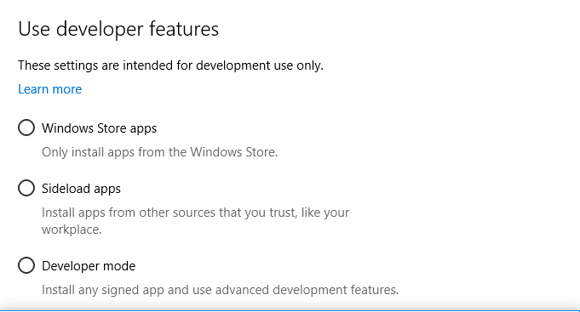
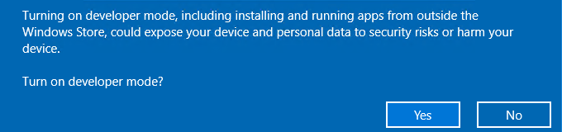
Show-WindowsDeveloperLicenseRegistration
Notes:
______________________________________________________
______________________________________________________
______________________________________________________
______________________________________________________
______________________________________________________
______________________________________________________
______________________________________________________
______________________________________________________
______________________________________________________

Slide 17
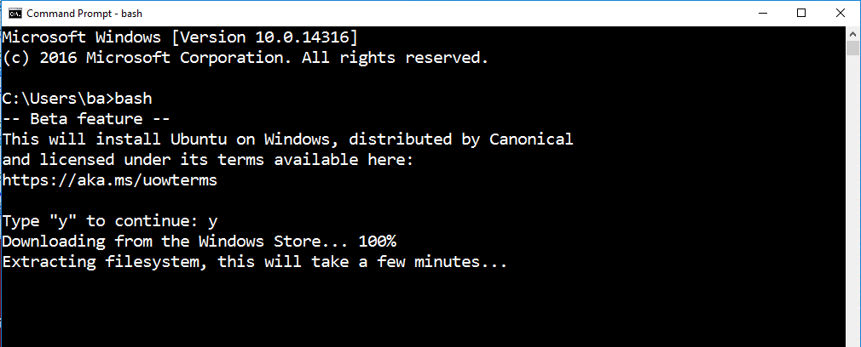
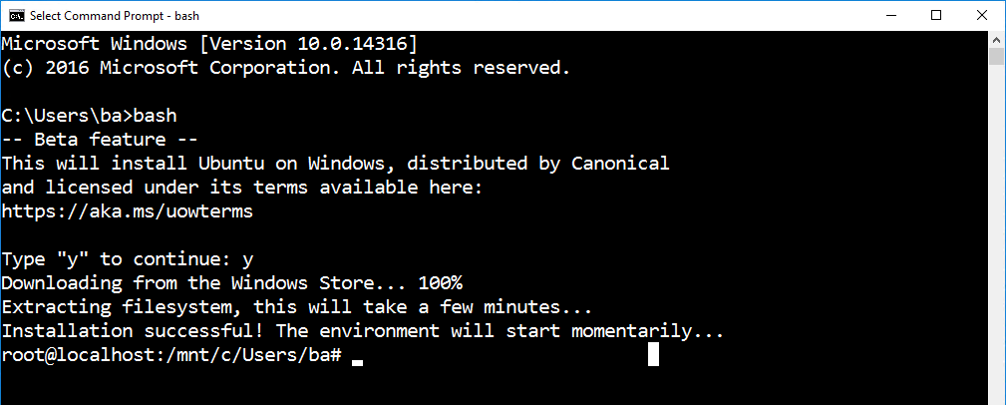
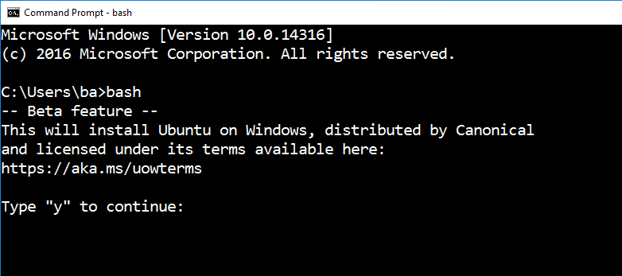
Notes:
______________________________________________________
______________________________________________________
______________________________________________________
______________________________________________________
______________________________________________________
______________________________________________________
______________________________________________________
______________________________________________________
______________________________________________________

Slide 18
Demo 2
Notes:
______________________________________________________
______________________________________________________
______________________________________________________
______________________________________________________
______________________________________________________
______________________________________________________
______________________________________________________
______________________________________________________
______________________________________________________

Slide 19
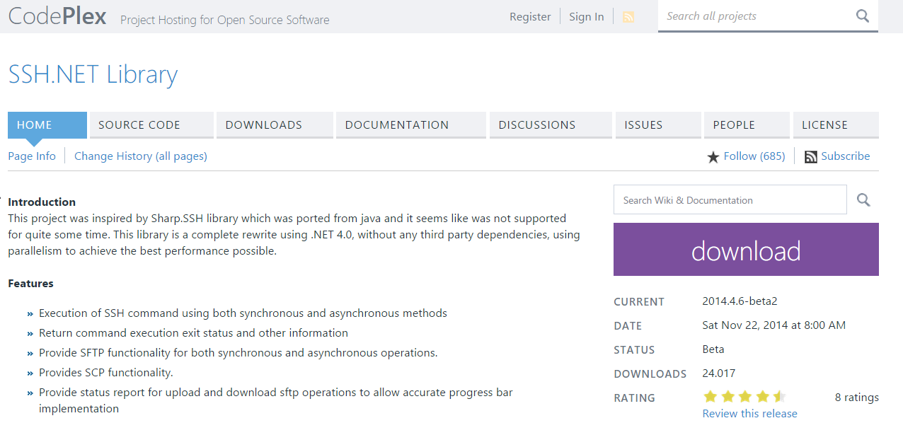
SSH.NET {sshnet.codeplex.com}
Notes:
______________________________________________________
______________________________________________________
______________________________________________________
______________________________________________________
______________________________________________________
______________________________________________________
______________________________________________________
______________________________________________________
______________________________________________________

Slide 20
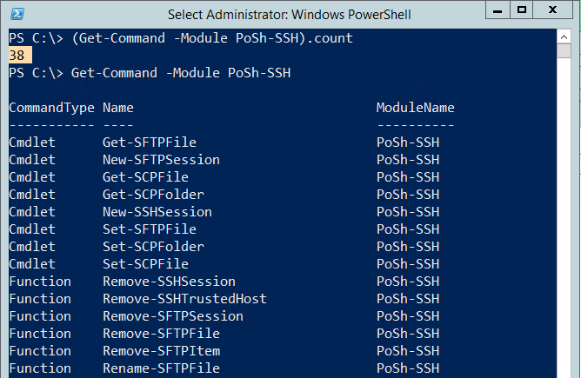
"PoSh-SSH" by Carlos Perez https://github.com/darkoperator/Posh-SSH
Notes:
______________________________________________________
______________________________________________________
______________________________________________________
______________________________________________________
______________________________________________________
______________________________________________________
______________________________________________________
______________________________________________________
______________________________________________________

Slide 21
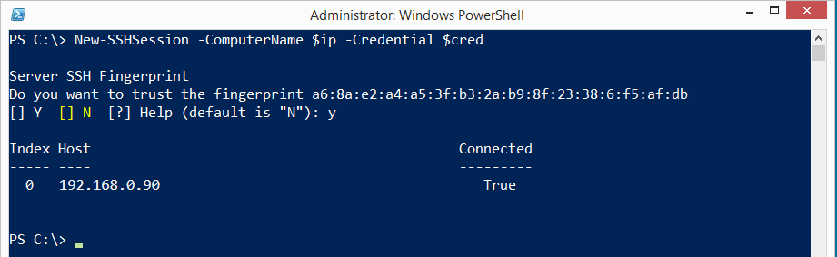
PoSh-SSH (by Carloz Perez)
Requires -Version 3.0
PoSh module written in C#
Open source
Notes:
______________________________________________________
______________________________________________________
______________________________________________________
______________________________________________________
______________________________________________________
______________________________________________________
______________________________________________________
______________________________________________________
______________________________________________________

Slide 22
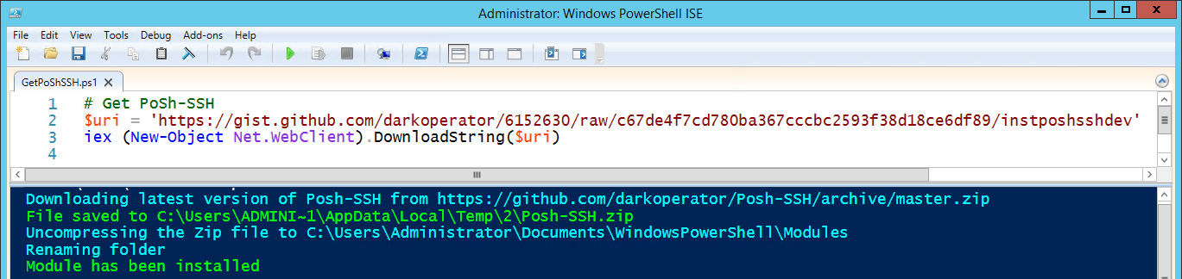
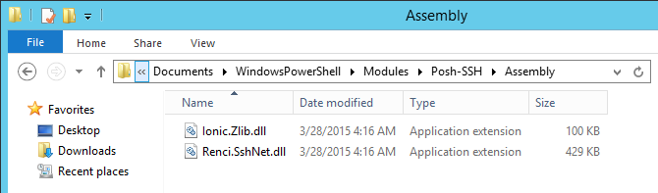
Demo 2: PoSh-SSH # Installation
Notes:
______________________________________________________
______________________________________________________
______________________________________________________
______________________________________________________
______________________________________________________
______________________________________________________
______________________________________________________
______________________________________________________
______________________________________________________

Slide 23
# Define variables
$vm = 'linux-vm.contoso.com'
$user = 'root'
$password = ConvertTo-SecureString -String 'Pa$$w0rd' -AsPlainText –Force
$cred = New-Object System.Management.Automation.PSCredential($user, $password)
# Test SSH port
Test-NetConnection -ComputerName $vm -Port 22 -InformationLevel Quiet
# Initiate session
$sshSession = New-SSHSession -ComputerName $vm -Credential $cred
# Remote command
Get-SSHSession # Mind the SessionID, pipelining not supported
Invoke-SSHCommand -Index 0 -Command 'uname -a'
Notes:
______________________________________________________
______________________________________________________
______________________________________________________
______________________________________________________
______________________________________________________
______________________________________________________
______________________________________________________
______________________________________________________
______________________________________________________

Slide 24
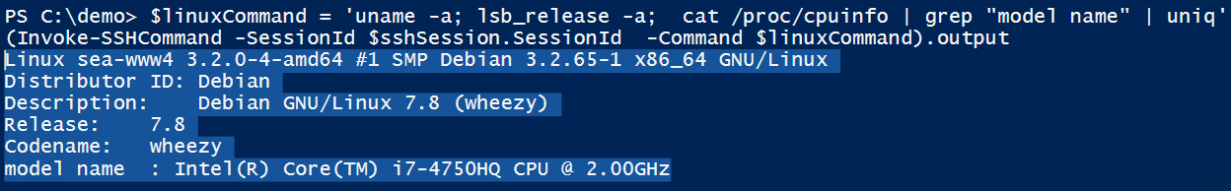
# Remote command, reloaded
(Invoke-SSHCommand -SessionId $sshSession.SessionId ` -Command 'uname -a').output
$linuxCommand = `
'uname -a; lsb_release -a; cat /proc/cpuinfo | grep "model name" | uniq'
(Invoke-SSHCommand -SessionId $sshSession.SessionId `
-Command $linuxCommand).output
# Close session
Get-SSHSession | Remove-SSHSession
Notes:
______________________________________________________
______________________________________________________
______________________________________________________
______________________________________________________
______________________________________________________
______________________________________________________
______________________________________________________
______________________________________________________
______________________________________________________

Slide 25
# Download single file
$configFullName = '/etc/network/interfaces'
$configFileName =
$configFullName.split("/")[$configFullName.split("/").count-1]
Get-SCPFile -ComputerName $vm -Credential $cred `
-LocalFile $configFileName -RemoteFile $configFullName
Get-Content $configFileName
# Download directory (recursive)
Get-SCPFolder -ComputerName $vm -Credential $cred `
-RemoteFolder '/etc/ssh' -LocalFolder 'c:\download'
Notes:
______________________________________________________
______________________________________________________
______________________________________________________
______________________________________________________
______________________________________________________
______________________________________________________
______________________________________________________
______________________________________________________
______________________________________________________

Slide 26
Questions?
@thorstenbutz
Notes:
______________________________________________________
______________________________________________________
______________________________________________________
______________________________________________________
______________________________________________________
______________________________________________________
______________________________________________________
______________________________________________________
______________________________________________________

Slide 27
Thank you!
@thorstenbutz
Notes:
______________________________________________________
______________________________________________________
______________________________________________________
______________________________________________________
______________________________________________________
______________________________________________________
______________________________________________________
______________________________________________________
______________________________________________________

